Slide 1
Enhancing IoT Security through SDN: A Comprehensive Approach
Presented By:
Ifra Ejaz (21L-7508)
Abdullah Awan(21L-7713)
Syed Ali Hassan Zaidi(211L-5274)

Slide 2
Table of Contents
Abstract
Introduction
Related work
Potential gaps
Research methodology
Experimentation details
Future directions
Conclusion
References

Slide 3
Abstract
SDN's transformative role in network management.
IoT security challenges and the need for improved threat detection.
Proposal: Integrating SDN and Random Forest (RF) for holistic IoT security.
Layered SDN framework with dynamic flow rules and attack mitigation.
Mixed-methods approach to assess proposed solution efficacy.
Enhanced threat detection accuracy, reduced false positives, and IoT security advancement through SDN integration.

Slide 4
Introduction
Problem Statement: IoT ecosystems face severe security vulnerabilities worsened by the inadequacies of conventional networking methods, demanding urgent solutions to safeguard against potential cyber threats and breaches.
Proposed Solution: Leveraging Software-Defined Networking (SDN) and machine learning to bolster IoT security.

Slide 5
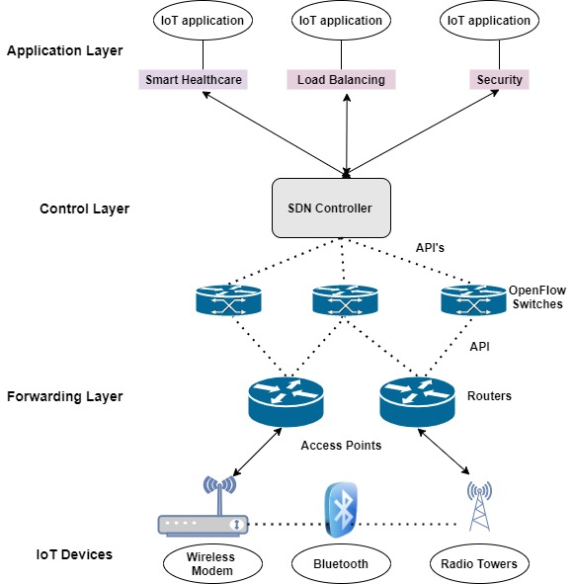
Approach: Centralizing the network

Slide 6
Related Work
Overcoming Legacy Limitations and Embracing Programmability:
Jamal et.al (2014) highlights how SDN simplifies network management through centralized control and programmability, overcoming the limitations of legacy networks.
Strategic SDN Controller Selection and Network Management:
Mishra & AlShehri (2017) suggest using the Analytic Hierarchy Process (AHP) for selecting the best controller, ensuring a decision that aligns with the network's specific needs and goals.

Slide 7
Software-Defined Networking: Enhancing Security, Revolutionizing Applications, and Shaping the Future of Network Management:
SDN's applications in various industries highlight its transformative impact on network configuration and management, offering dynamic resource allocation and intelligent control over network operations.
Multiple Controllers in SDN: Enhancing Network Management through Scalability and Reliability:
This paper proposes using multiple controllers in SDN networks to improve security outlining different design principles, architectures, placement strategies, and scheduling technique

Slide 8
Implementation of Multiple controllers
This paper outlines different design principles, architectures, placement strategies, and scheduling techniques for multiple controller implementations in SDN.
Enhancing IoT Security through Machine Learning and SDN Integration: Challenges and Opportunities:
This paper discusses the convergence of machine learning (ML), IoT security, and the role of SDN in improving IoT security postures. It emphasizes the need for sophisticated security frameworks and best practices to address IoT's security challenges

Slide 9
Potential Gaps
Little is known about how SDN may improve energy efficiency and offer complete, end-to-end security solutions.
Challenges such as intricate inter-controller communication protocols and scalability issues in SDN and ML solutions, notably in IoT security, require further investigation to close the gap.

Slide 10
Research Methodology
Qualitative analysis
Synthesis & conclusion
01
02
03
04
Data Collection
Quantitative analysis

Slide 11

Research Methodology
Research Design:
Adopted a mixed-methods approach for in-depth exploration of SDN's role in IoT security, combining quantitative and qualitative analysis.
Validated research through secondary methods to establish a solid theoretical foundation and position the study within existing knowledge.

Slide 12
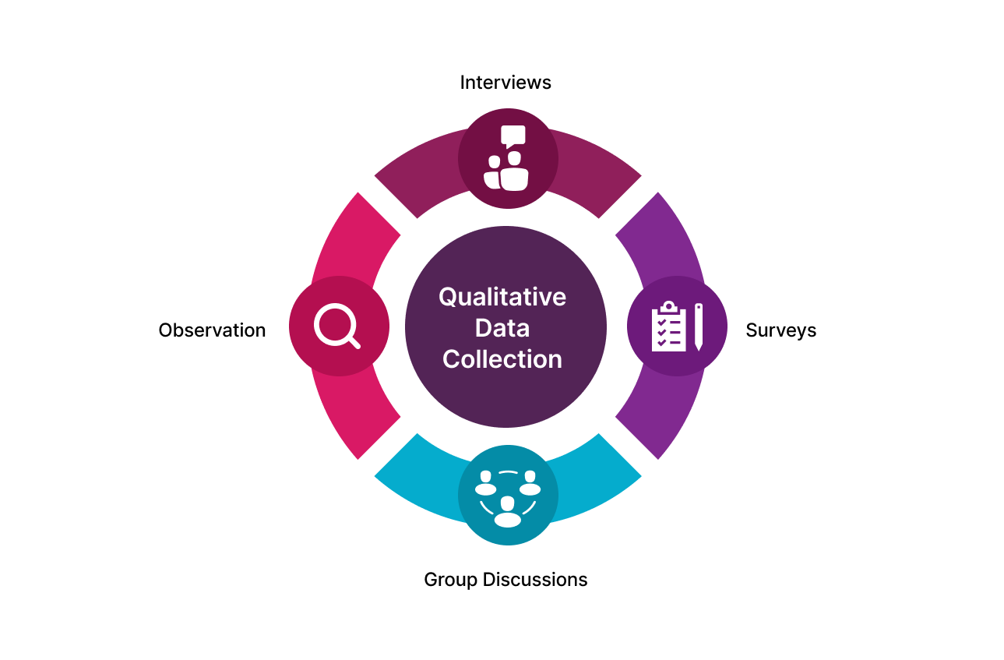
Research Methodology
Data Collection:
Secondary Research
Literature Review
Surveys
Interviews

Slide 13
Research Methodology
Qualitative Data Analysis:
Analyzed recorded opinions and experiences of individuals directly involved in IoT and SDN domains to offer insights that cannot be quantified.
Examined case studies where SDN was used to resolve IoT security concerns, providing rich insights into specific problems, solutions, and lessons learned.

Slide 14
Research Methodology
Quantitative Data Analysis:
Obtained statistics on security issues frequency, SDN adoption rate, and perceived efficacy through quantitative surveys of IT professionals and organizations.

Slide 15
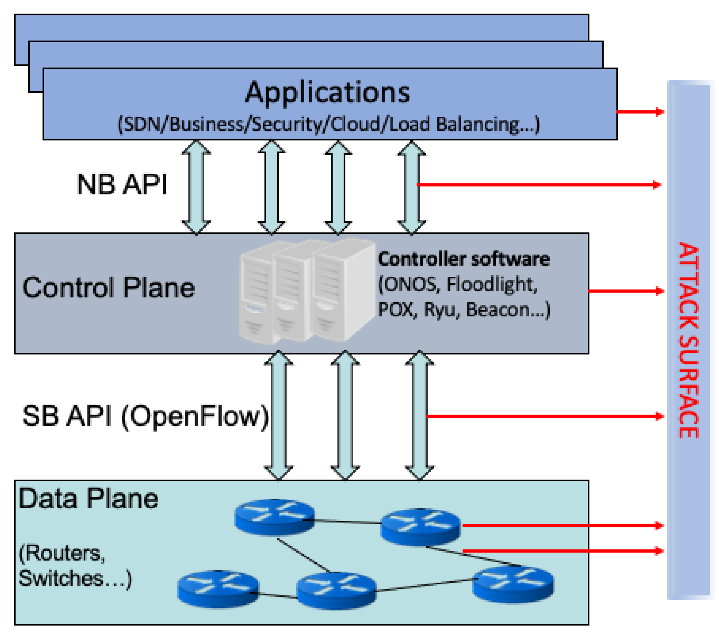
Experimentation & Implementation
Layered Architecture of SDN
Proposed Solution:
Feature Creation
RF classifier
Attack mitigator

Slide 16

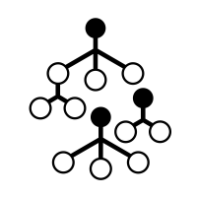

End-to-end operation
Algorithm 1: feature creation
Algorithm 2: attack mitigation
Feature Creation
Attack Mitigator
RF Classifier

Slide 17
Algorithm 1: Feature Creation
Le flow entries
F feature vector
For all e in Le do:
F.common_features calculate common features(e)
F.specific_features extract_flow_specific_features(e)
F.supplementary_data get_data(e)
If ismalicious(F):
classification = “attack”
Else:
classification = “normal”
If classification == “attack”
Mitigate_attack(F,classification)

Slide 18
Algorithm 2: Attack Mitigation
blacklist set()
def Mitigate_attack(F,C):
If C==“attack”:
If F not in blacklist:
Flow_entry=create_flow_entry(F)
Install_flow_entry(flow_entry)
Update_blacklist(F)
def create_flow_entry(F):
Flow_entry={ “source_identifiers” : F; “action” : “drop”;}
Return flow_entry
def install_flow_entry(F):
Priority=“high”;
Switch.install_flow_entry(F,priotity)

Slide 19
Future Directions
The proposed security solution will be practically implemented to validate its efficacy
Testbed environments will be used to evaluate the system's scalability and performance
Compatibility with popular SDN controllers like ONOS and OpenDaylight will be ensured
Ongoing research efforts will focus on refining the security solution based on feedback from real-world deployments

Slide 20
Conclusion
The integration of SDN and machine learning, particularly the Random Forest classifier, offers a transformative strategy for enhancing IoT security.
SDN's centralized control and programmability enable efficient management and security enhancement in IoT ecosystems.
Expected outcomes include improved accuracy, efficiency, and reduced false positives in threat detection, highlighting the potential of SDN to revolutionize IoT security.

Slide 21
References
[1] M. Jammal, T. Singh, A. Shami, R. Asal, and Y. Li, “Software defined networking: State of the art and research challenges,” Computer Networks, vol. 72, pp. 74–98, Oct. 2014, doi: https://doi.org/10.1016/j.comnet.2014.07.004.
[2] S. Mishra and M. A. R. AlShehri, “Software Defined Networking: Research Issues, Challenges and Opportunities,” Indian Journal of Science and Technology, vol. 10, no. 29, pp. 1–9, Feb. 2017, doi: https://doi.org/10.17485/ijst/2017/v10i29/112447.
[3] “(PDF) Software-Defined Networking: Challengesand research opportunities for Future Internet,”
ResearchGate. https://www.researchgate.net/publication/267339360_
Software-Defined_Networking_Challenges_and_research_opportunities_for_Future_Internet
[4] K. Gaur, P. Choudhary, P. Yadav, A. Jain, and P.Kumar, “Software Defined Networking: A review on Architecture, Security and Applications,” IOP Conference Series. Materials Science and Engineering, vol. 1099, no. 1, p. 012073, Mar. 2021, doi: 10.1088/1757-899x/1099/1/012073.
[6] Y. Zhang, L. Cui, W. Wang, and Y. Zhang, “A survey on software defined networking with multiple controllers,” Journal of Network and Computer Applications, vol. 103, pp. 101–118, Feb. 2018, doi: 10.1016/j.jnca.2017.11.015.
[7] P. Williams, I. K. Dutta, H. Daoud, and M. Bayoumi, “A survey on security in internet of things with a focus on the impact of emerging technologies,” Internet of Things, vol. 19, p. 100564, Aug. 2022, doi: 10.1016/j.iot.2022.100564.
[8] “Google Scholar.” https://scholar.google.com/scholar?q=D.+E.+Kouicem, +A.+Bouabdallah,+and+H.+Lakhlef,+Internet+of+Things+security:+a+top-down+survey,+Comput.+Netw.,+vol.+141,+pp.+199 221,+Aug.+2018.&hl=en&as_sdt=0,5&as_rr=1
[9]https://www.researchgate.net/publication/309227061_Energy_Efficiency_in_Mobile_Cloud_Computing_Architure

